Slide 1
Intro to NLP
Shabnam Tafreshi, PhD
Assistant Research Scientist
UMD: ARLIS
Spring 2023
Guest Lecturer

Slide 2
Introduction
First, some inequalities
NLP != Computational Linguistics
NLP != Machine Learning with text
NLP is a subset of CL
NLP focuses on the engineering of useful language applications
CL encompasses both NLP and the scientific study of human language from a computational perspective
But how does language work?
What makes a language a language?
What are people actually doing when they produce or comprehend language?

Slide 3
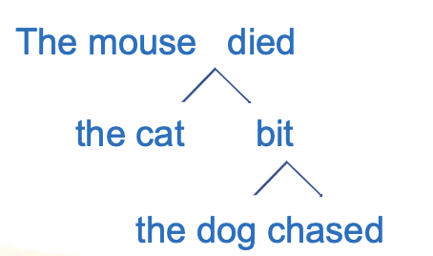
Language
Some crucial properties include:
Semanticity, particularly the arbitrary relation of sounds to meanings
Latent structure, as opposed simply to sequential patterns
Recursion, and particularly center-embedding recursion

Slide 4
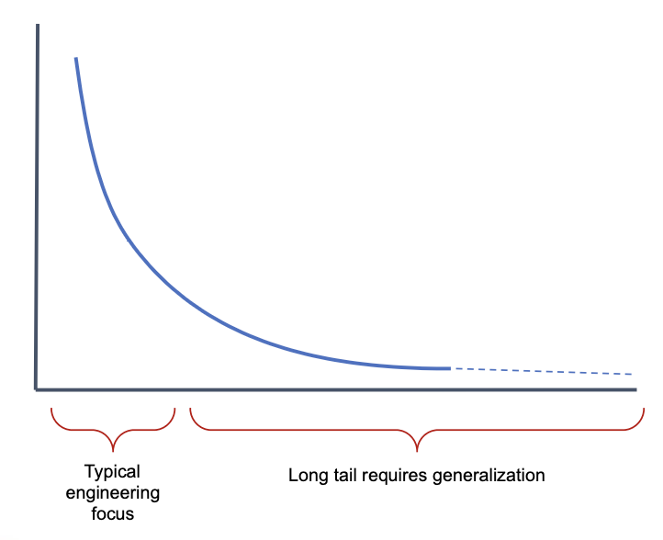
Zipfian curve
Rank of words vs Frequency of words
Engineers like to focus on the first section
Scientists like to focus on the latter section

Slide 5
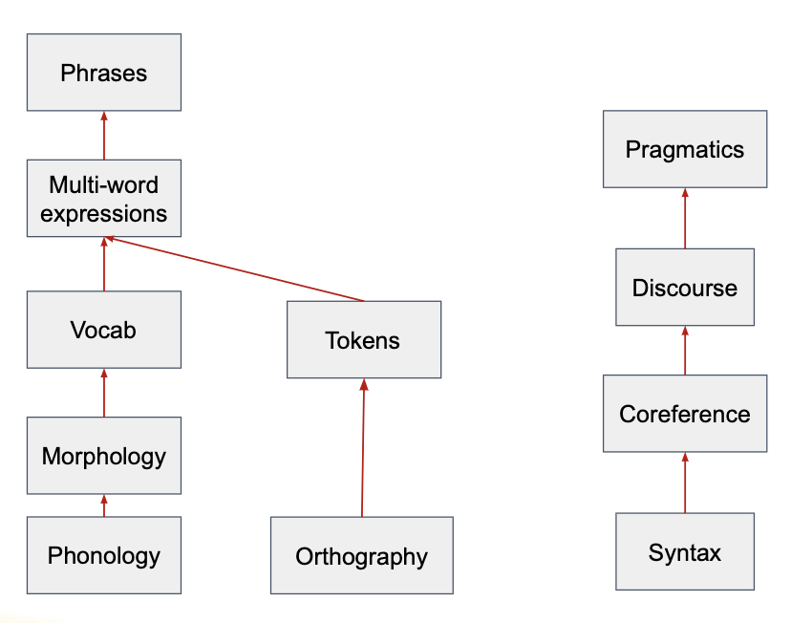
Layers of Language Considerations...

Slide 6
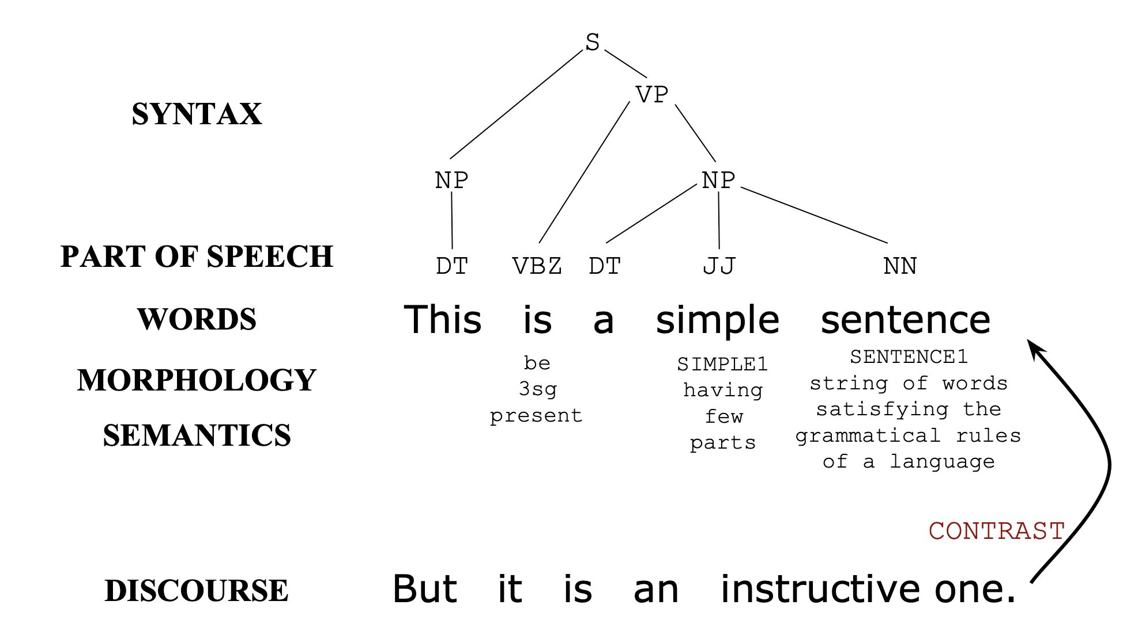

Slide 7
A Historical Perspective on Approaches in NLP (1/3)
1950-60s
ELIZA (1966)
Early neural methods (perceptron)
Word-based machine translation
Symbolic AI (GOFAI)
1970s-mid 1980s
Heyday of rule-based approaches and “language understanding”
Profusion of computationally focused grammar formalisms
Connectionist/Parallel Distributed Processing returns to neural methods

Slide 8
A Historical Perspective on Approaches in NLP (2/3)
Late 1980s-1990s
Rise of supervised machine learning methods (the “statistical NLP” era)
Focus on “tasks” rather than the larger goal of language understanding
1990s-2000s
Consolidation of machine learning as the dominant approach
Emphasis on learning from annotated data

Slide 9
A Historical Perspective on Approaches in NLP (3/3)
2010 to now
Renaissance of neural methods (deep learning) starting ~2010
Availability of huge quantities of unannotated or found-annotated data
Availability of vast computing power
Realistic-sounding language generation (and associated hype)
NLP as a publicly visible part of daily life (Siri, Alexa, Google Translate…)

Slide 10
Text Pre-processing

Slide 11
Tokenization / Normalization
Tokenization split a sentence or paragraph into smaller units. Common approaches:
Via spaces
Remove punctuation and use spaces
Will this work for other languages, though?
See: Chinese, Japanese, Thai
Toolkits that are handy for tokenization:
SpaCy, NLTK are battle-tested and have nice out-of-the-box capabilities

Slide 12
Tokenization / Normalization
Normalization is the creation of equivalence classes, so that you can effectively prune your vocabulary and capture commonalities
This is also highly language-specific
Examples include:
Lowercasing (Matter ➔ matter)
Stemming
(destruction, destroy, destroying) ➔ destr
Lemmatization / morphological analysis
Puppies -> lemma (root): puppy, num: plural, pos: noun

Slide 13
Language Models

Slide 14
Language Models
Language models Models that assign probabilities to sequences of words are called language models or LMs
N-Gram is the simplest model that assigns probabilities to sentences and sequences of words:
An n-gram is a sequence of n words: a 2-gram (bi-gram) is a two-word sequence of words.
Please return your homework
Bi-gram: “please return” “return your” “your homework”

Slide 15
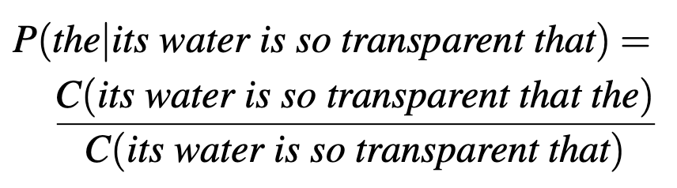

N-Gram Models
Computing P(w|h), the probability of a word w given some history h.
What about the following sentence:
“Walden Pond’s water is so transparent that the” COUNT = 0 ☹

Slide 16
Chain Rule of Probability (1/2)
Pr(a,b,c) = Pr(a) Pr(b|a) Pr(c|a,b)
Applying this formula to tokenized string:
Pr(w1, w2, …, wn) = Pr(w1) Pr(w2|w1) Pr(w3 | w1 w2) … Pr(wn | w1 … wn-1)
This generative process can get complex, quick!
Pr(w1) Requires O(V) parameters
Pr(w2 | w1) Requires O(V^2) parameters
Pr (w3 | w1 w2) Requires O(V^3) parameters
Where V refers to the number of words in the corpus vocabulary

Slide 17
Chain Rule of Probability (2/2)
Observation: Remember Zipf’s law. Most of these word combinations are low-frequency or never-before-seen.

Slide 18
Markov Model (1/2)
Markov model assumes the Markov property
1st order Markov: Pr(wi | w1 … wi-1) is presumed equal to Pr(wi | wi-1)
Bigram model = 1st-order Markov approximation
Effectively simplifying the problem by defining the previous word as an equivalence class of all histories ending with that word

Slide 19
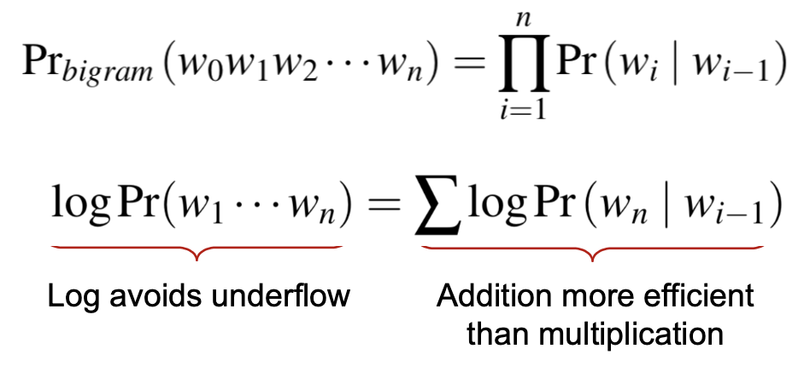
Markov Model (2/2)
To make life easier we assume w₀ is a special START symbol such that Pr(w₀) = 1.

Slide 20
Word Semantic and Embedding

Slide 21
Lexical Semantic
- Cold is the opposite of Warm
- Cat is similar to Dog
- Buy sell pay
If I buy something from you, you’ve probably sold it to me, and I likely paid you

Slide 22
Vector Semantic
Ongchoi is delicious sauteed with garlic.
Ongchoi is superb over rice. ...ongchoi leaves with salty sauces...
And suppose that you had seen many of these context words in other contexts:
...spinach sauteed with garlic over rice...
...chard stems and leaves are delicious...
...collard greens and other salty leafy greens

Slide 23
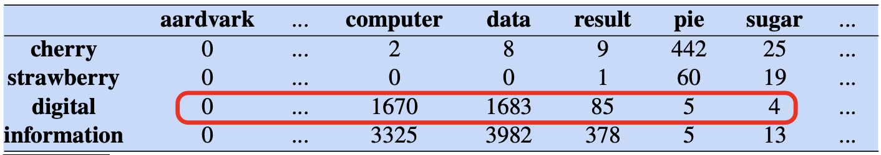
Vector Semantic
Cherry & Strawberry are similar: both have pie & sugar as surrounding context (windows size of +/- 4)
Digital & Information are similar: both have computer, data, & result as surrounding context (windows size of +/- 4)

Slide 24
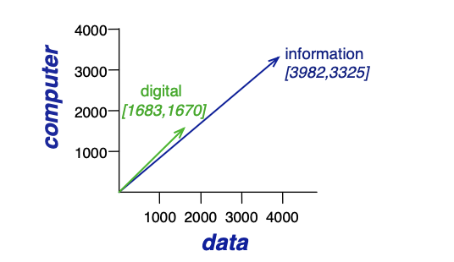
Vector Semantic
A spatial visualization of word vectors for digital and information, showing just two of the dimensions, corresponding to the words data and computer.

Slide 25
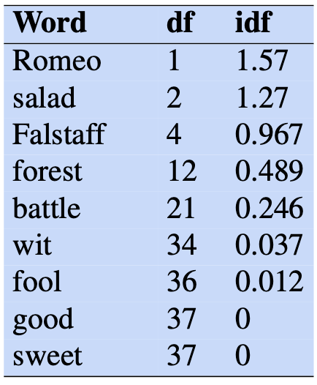
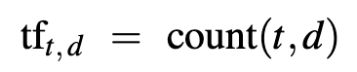
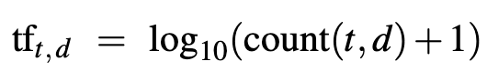
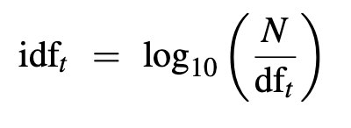
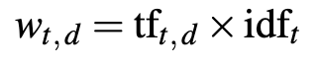
Tf-idf: Weighing terms in the vector
Words like “the, she, a, good” are very frequent
Shakespeare play

Slide 26
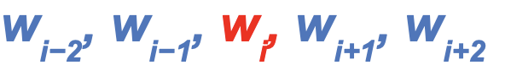

word2vec
Continuous Bag of Words (CBOW)
Given the context predict the word:
Example: The cat ate _____.
Fill in the blank, e.g. “food”.
-Faster to train
-Works well for a large amount of training data
Continuous Skip-Gram
Given the word predict the context:
Ex: ___ ___ ___ food.
Fill in the blank, e.g. “The cat ate”
-Slower to train
-Works better for infrequent words

Slide 27
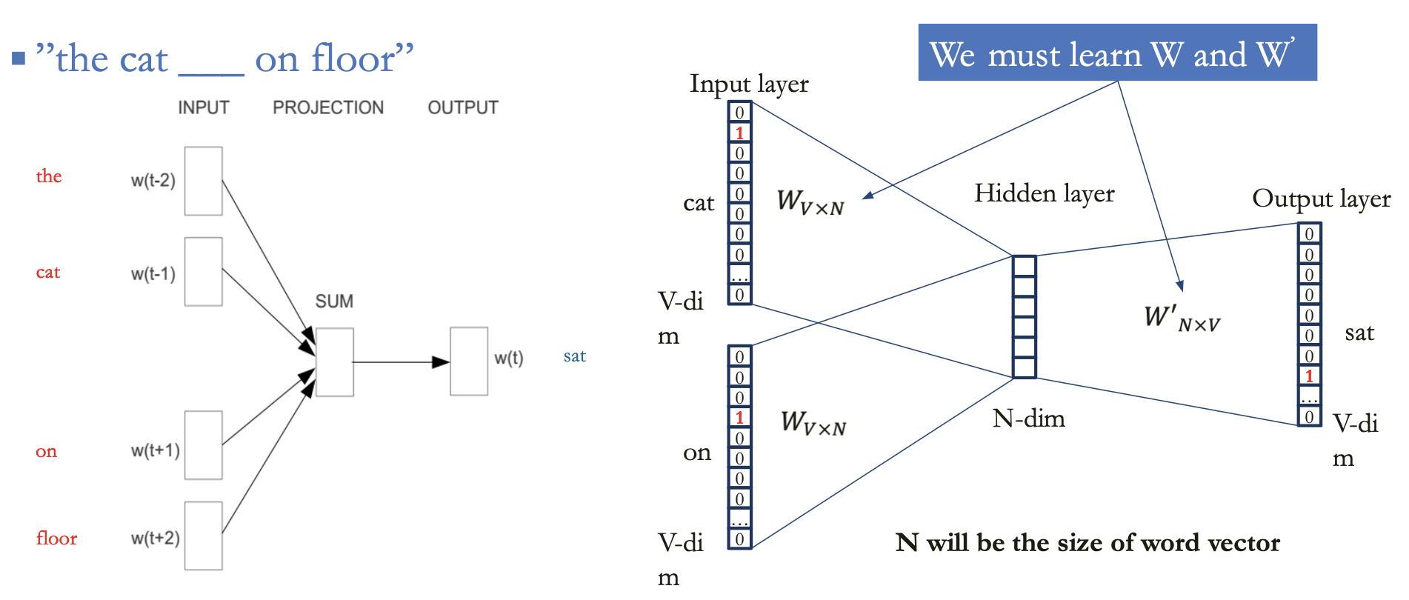
W2V CBOW

Slide 28
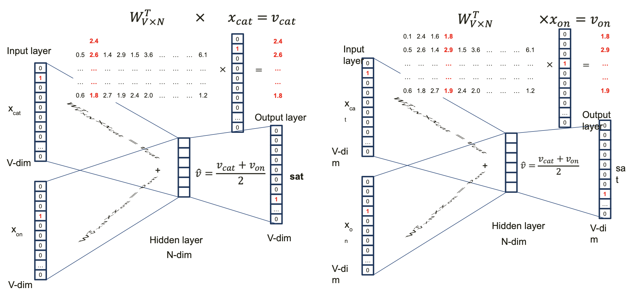
Learning Connection Weights in W2V

Slide 29
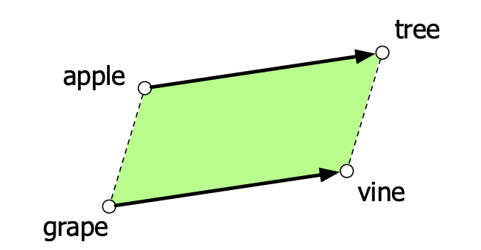
Analogy/Relational Similarity
The parallelogram model for analogy problems the location of vine can be found by subtracting apple from tree and adding grape.

Slide 30
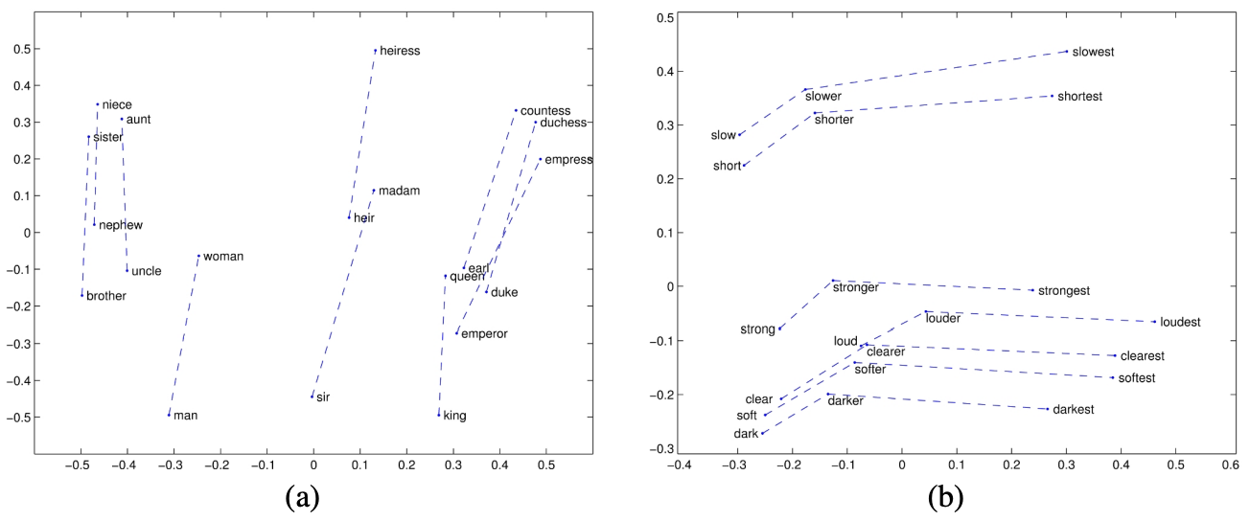
(a) Relational properties of the GloVe vector space, shown by projecting vectors onto two dimensions. (a) king − man + woman is close to queen.
(b) offsets seem to capture comparative and superlative morphology.

Slide 31
Intro to Neural Network and NLP

Slide 32
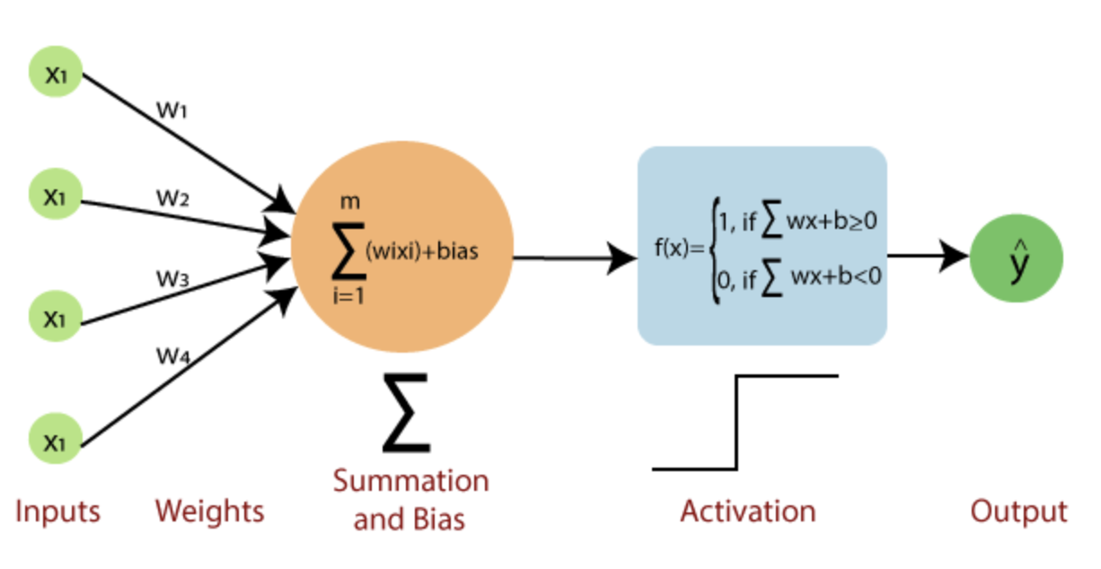
Intro to Neural Network
Single Neuron - perceptron model

Slide 33
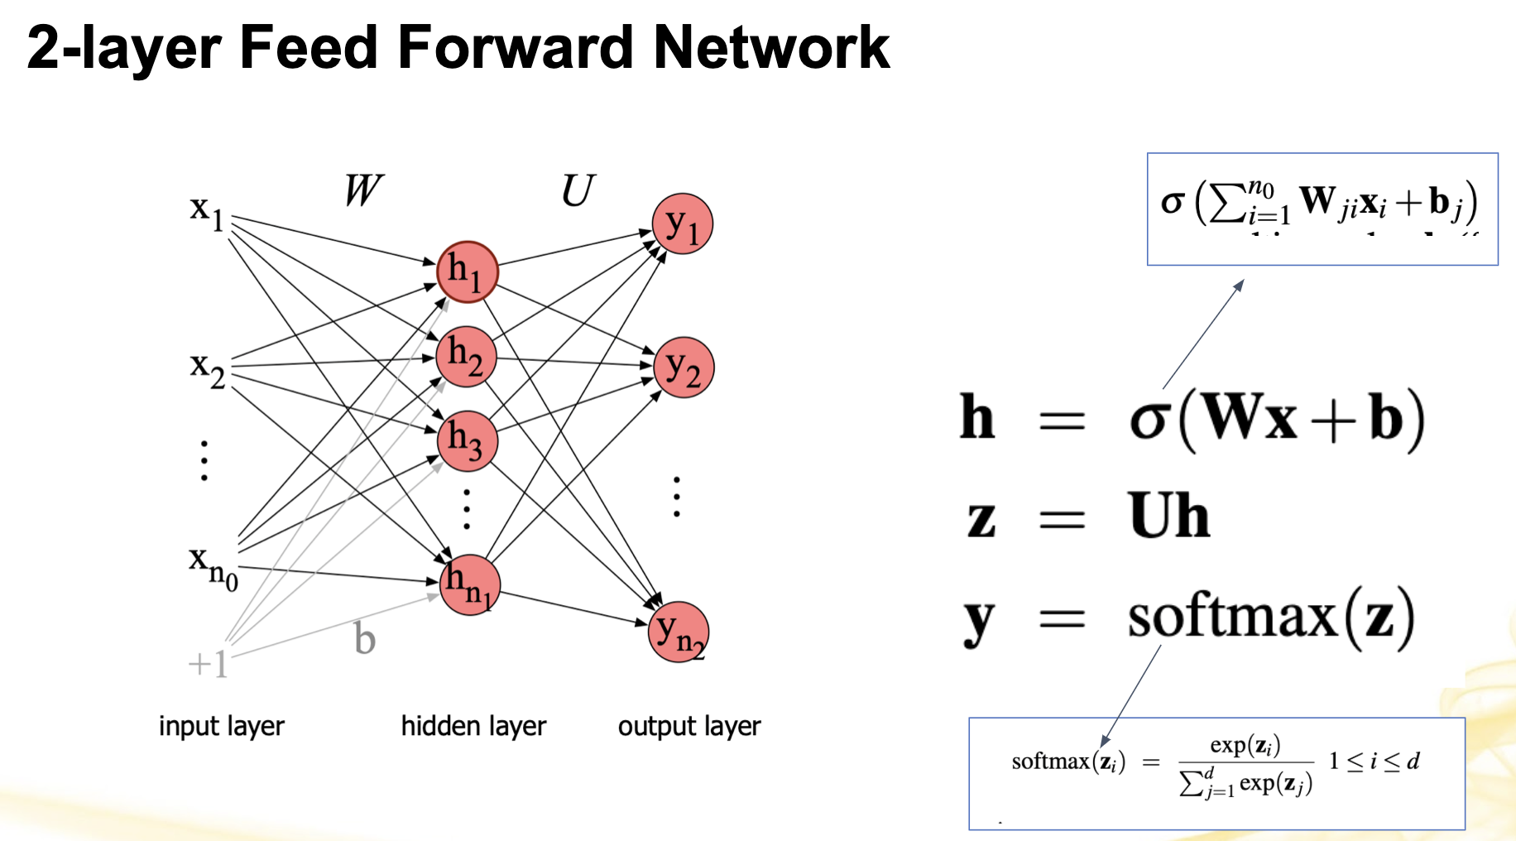

Slide 34
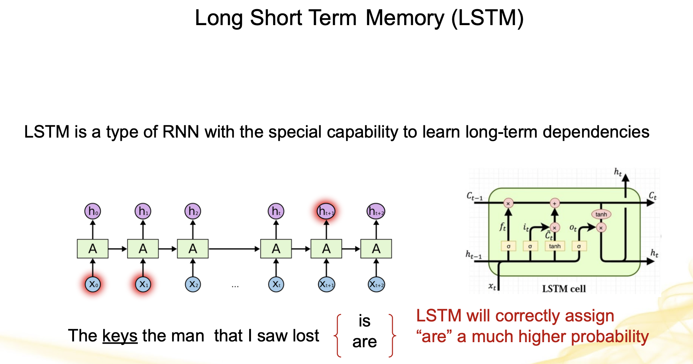

Slide 35
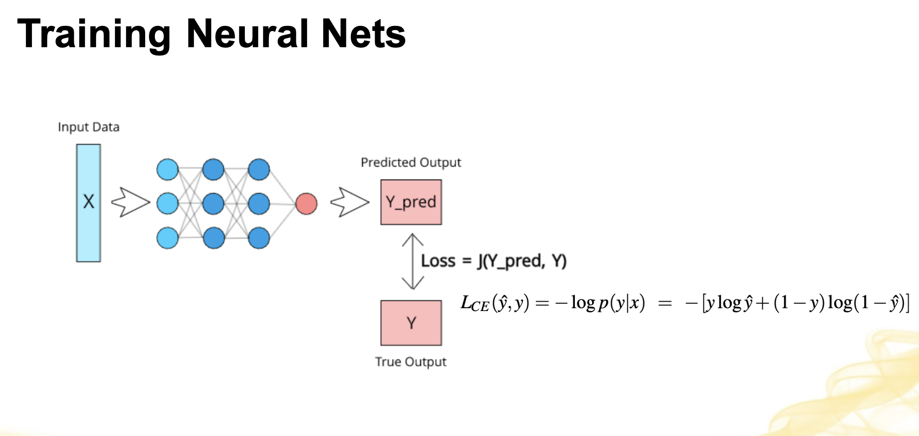

Slide 36
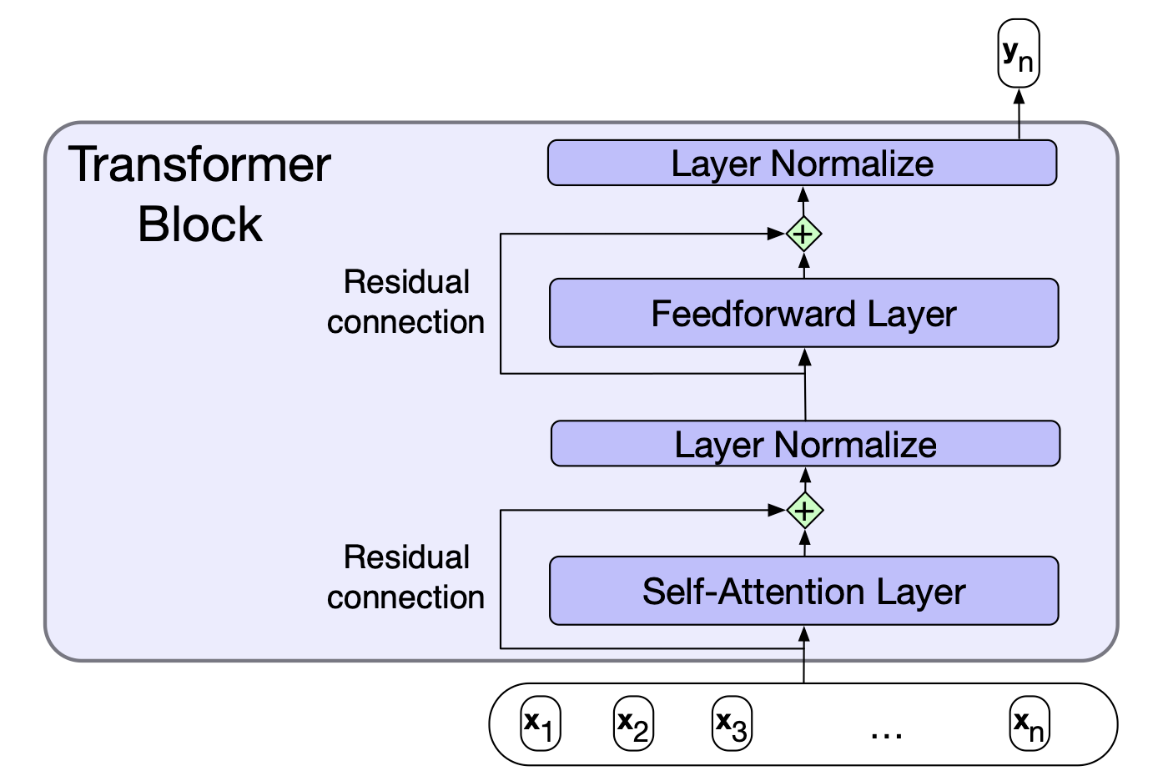
Transformer Block

Slide 37
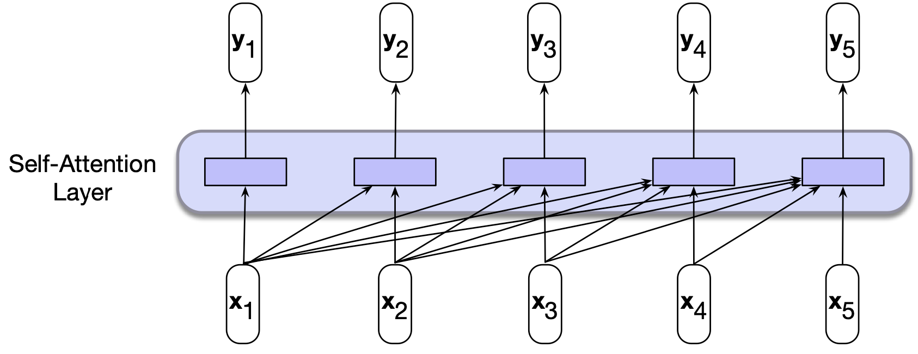
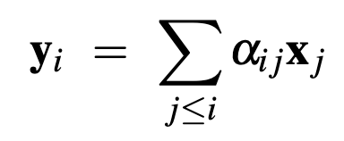
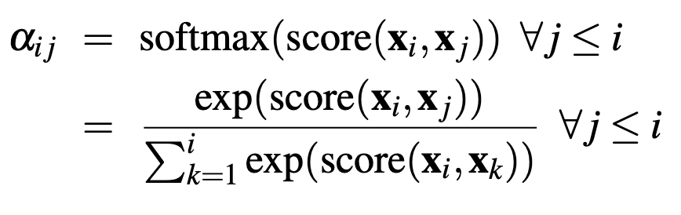
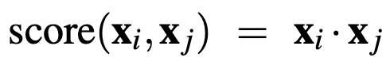
Self-Attention Layer

Slide 38
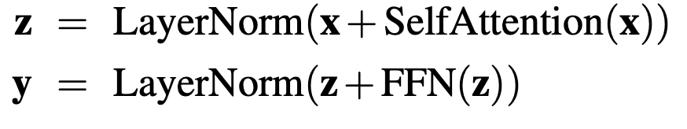
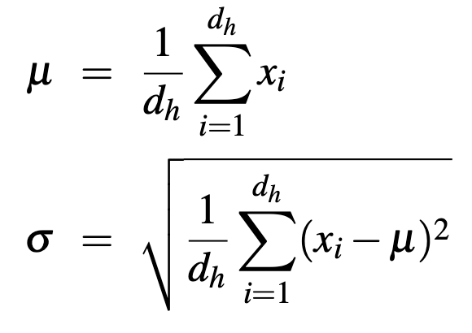
Transformer Block
Residual connections are a layer’s input vector to its output vector before passing it forward. This layer Improves learning and gives higher-level layers direct access to information from lower layers
Layer Norm is a normalization method to keep the hidden layers in a range to facilitate gradient-based training. The layer norm can be a z-score.
A layer is a long vector of units

Slide 39
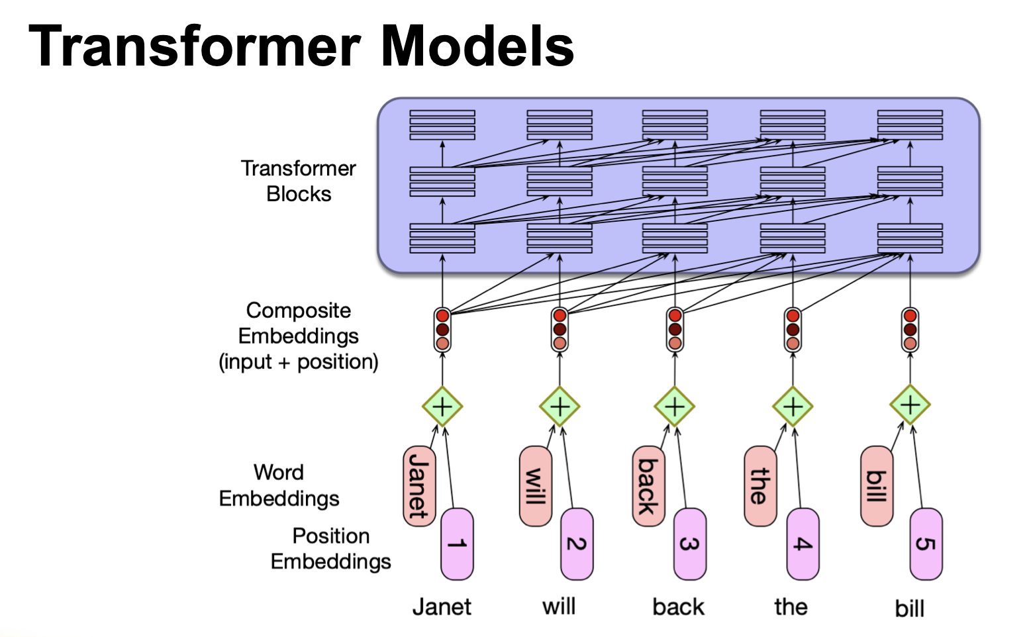

Slide 40
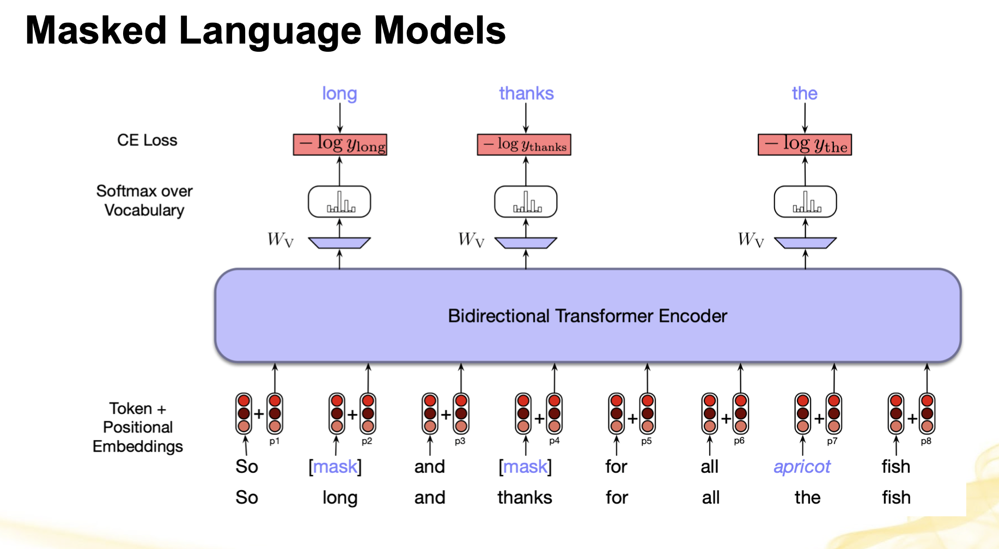

Slide 41
Neural Network in NLP Downstream Tasks(With the focus to be Text Classification)

Slide 42
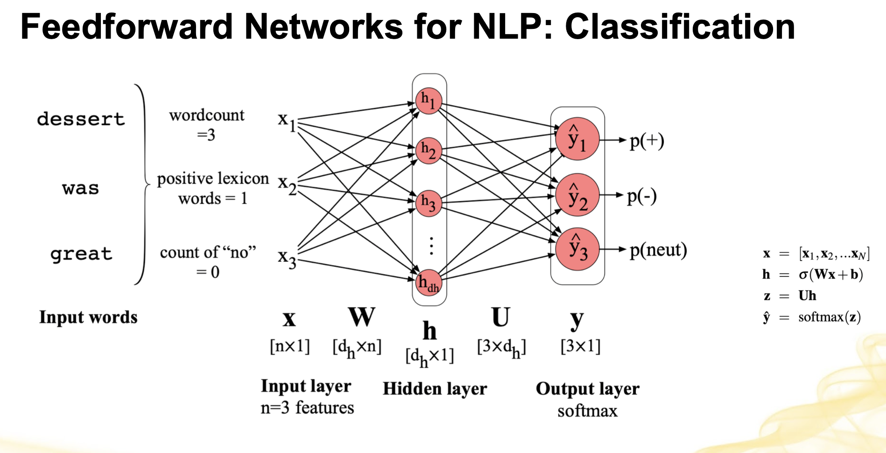

Slide 43
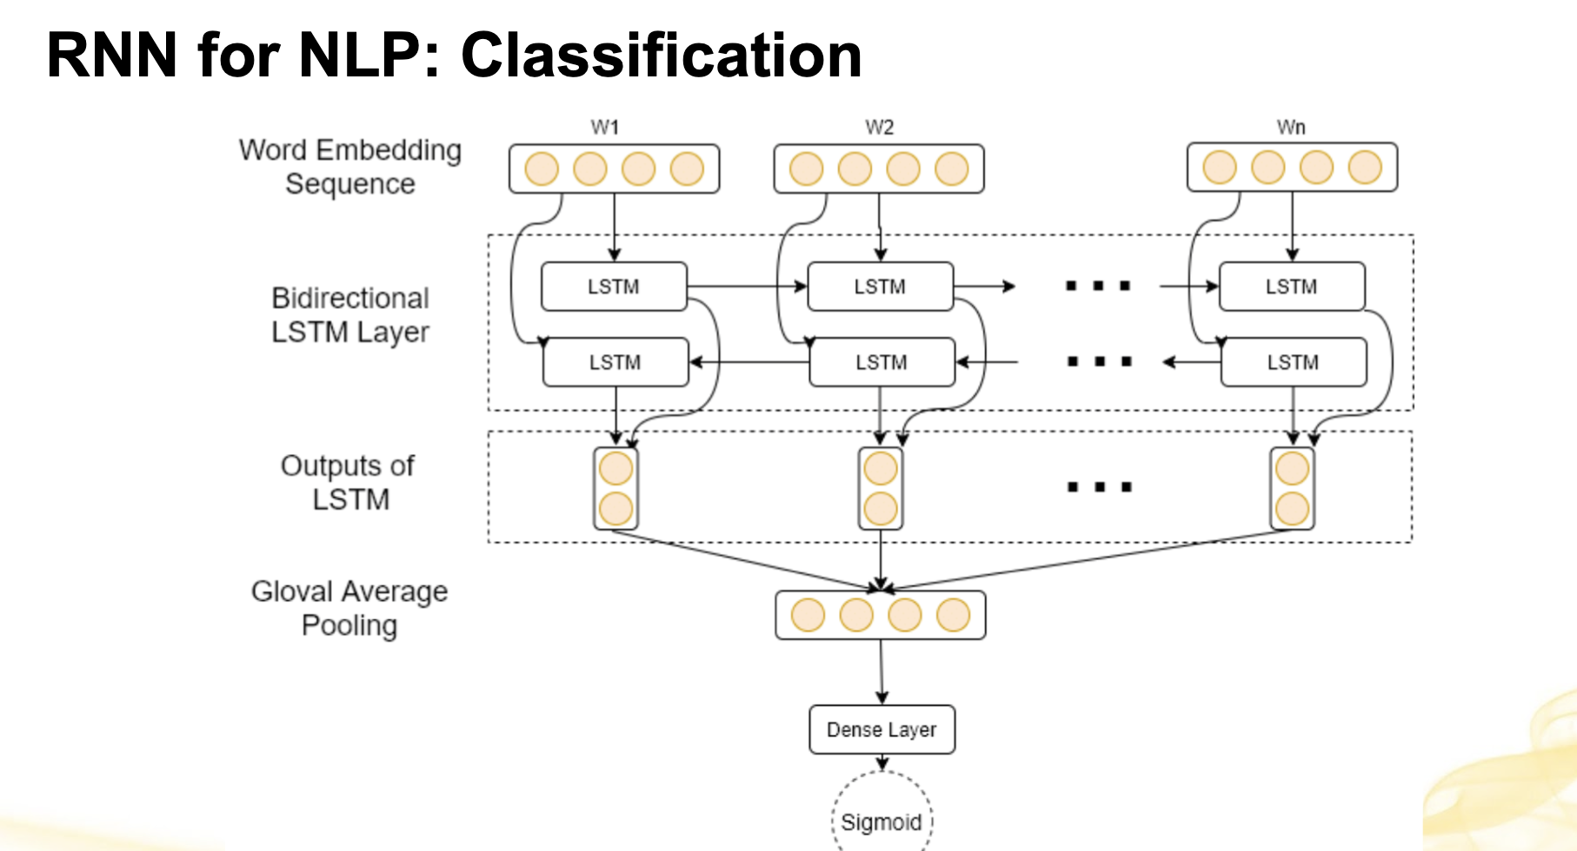

Slide 44
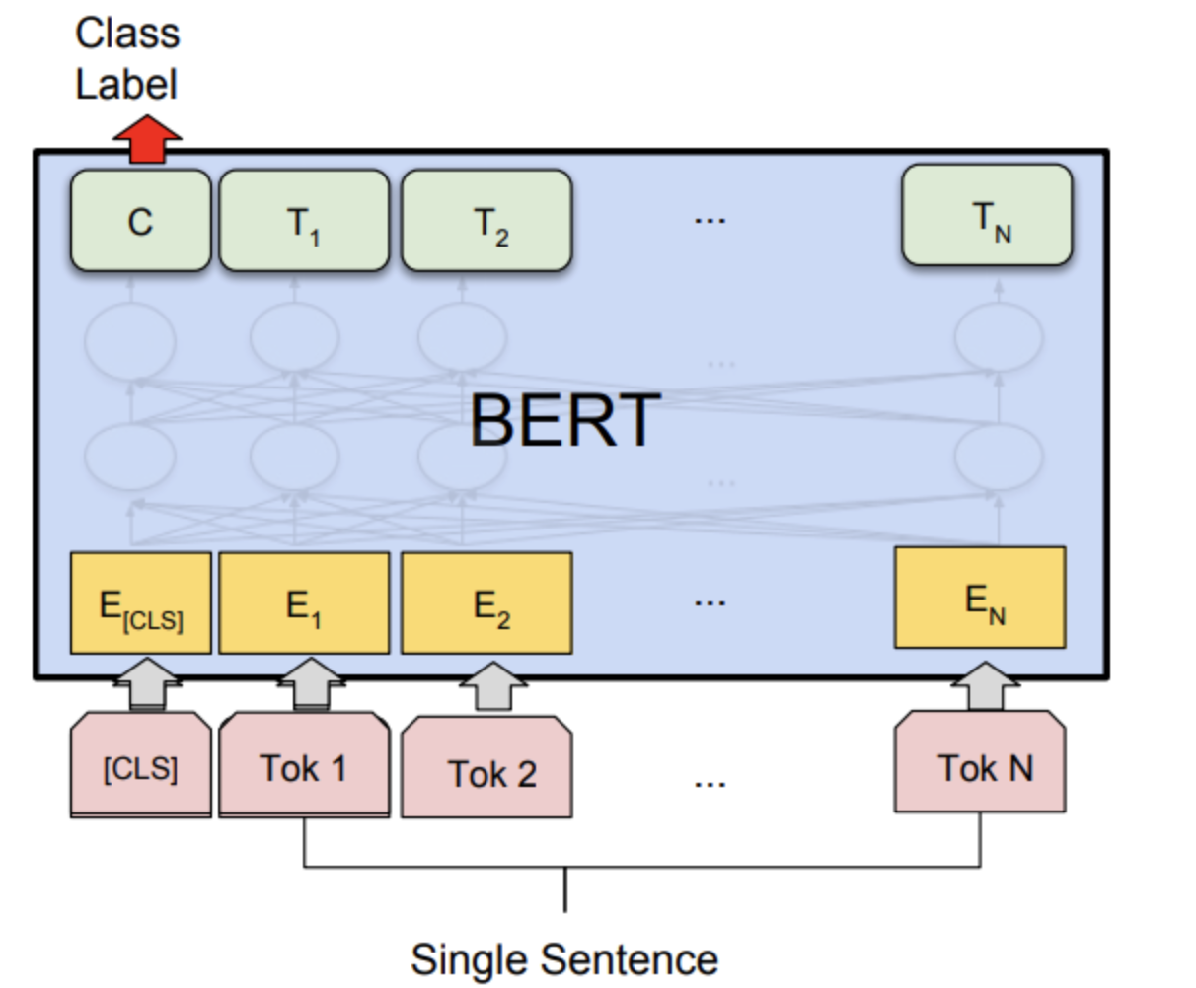
Transformer for NLP: Classification

Slide 45

-Q -A

Slide 46
Question Answering and Information Retrieval
Information- retrieval-based QA (open domain QA)
knowledge-base QA
Most QA focused on factoid questions

Slide 47
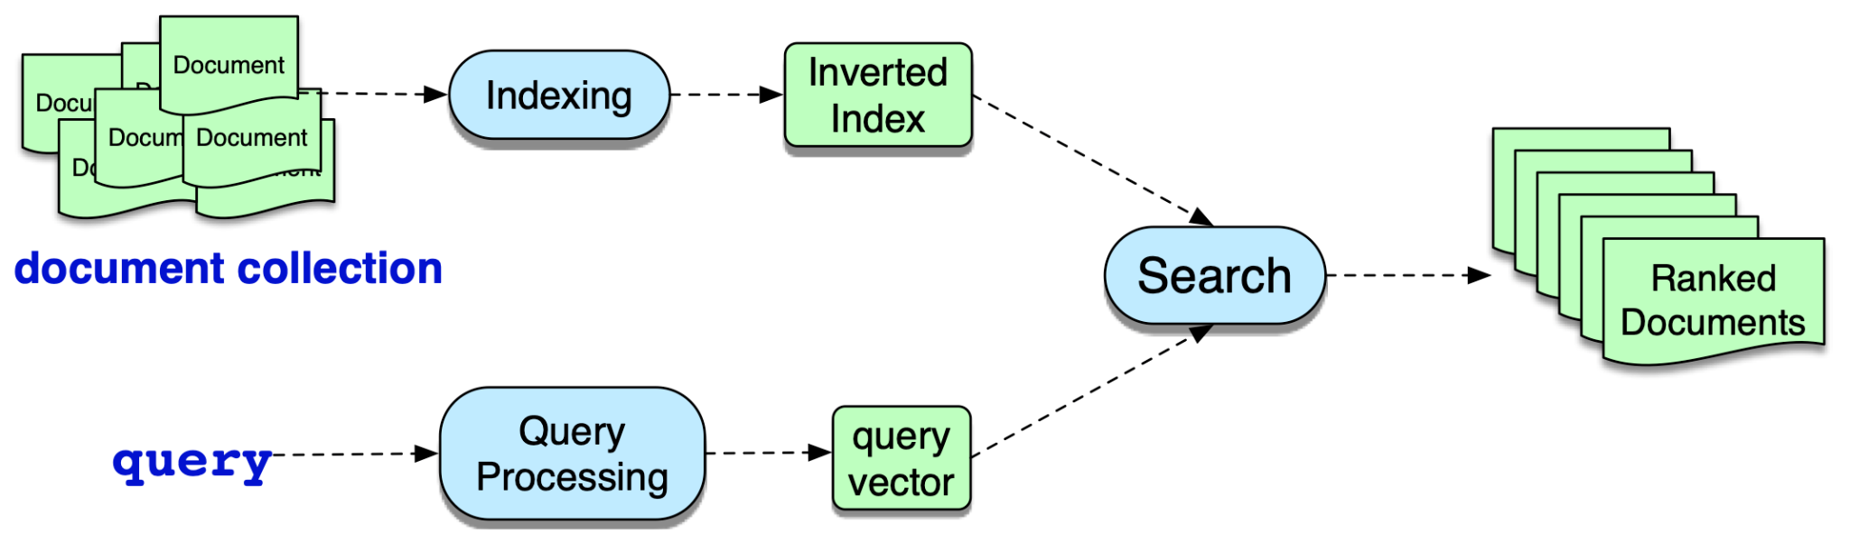
IR System

Slide 48
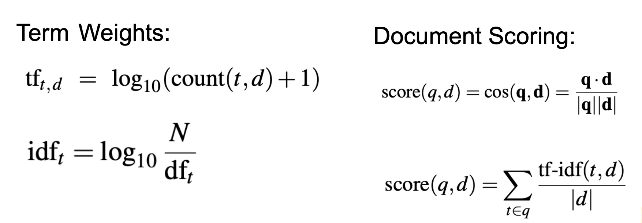
Term Weights & Document Scoring (1/2)

Slide 49
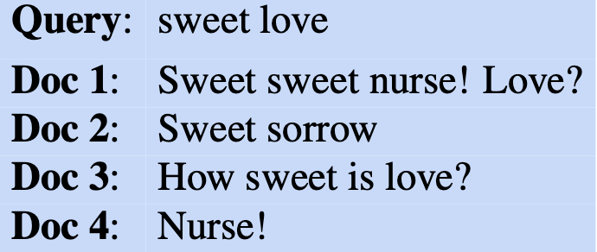
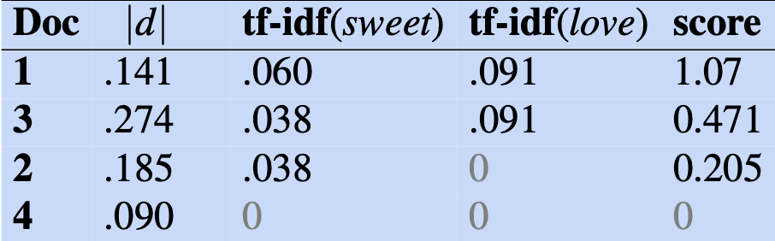
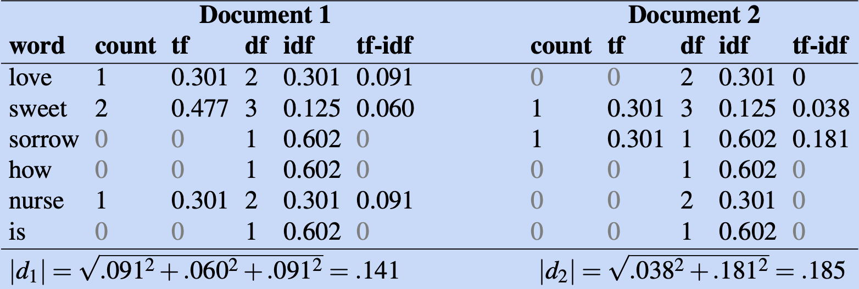
Term Weights & Document Scoring (2/2)

Slide 50
Chatbots & Dialogue Systems

Slide 51
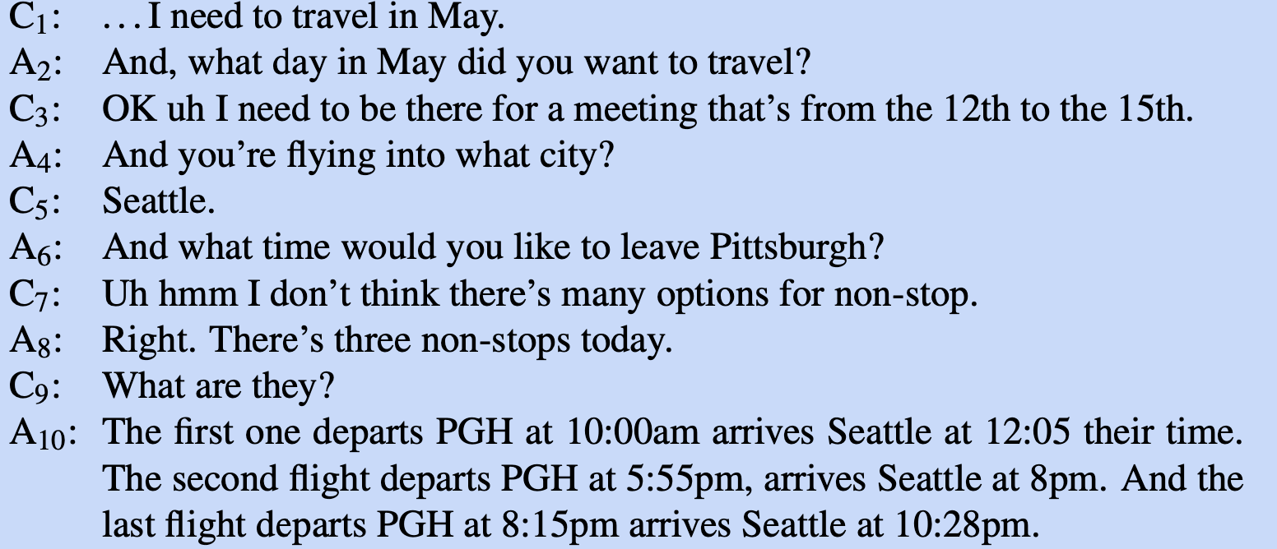
Turns
Turns: C1, A2, C3, etc.

Slide 52
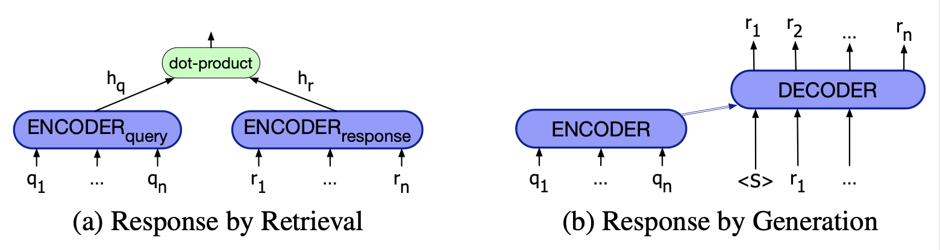
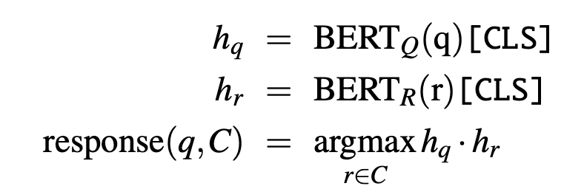
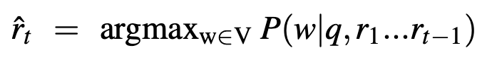
Architecture for Generating Response

Slide 53
References
https://web.stanford.edu/~jurafsky/slp3/
Images and materials belong to Speech and Language Processing (3rd ed. draft)
Dan Jurafsky and James H. Martin; the most popular NLP text book.

